Slide 1
Food Wastage Reduction by Donation to Charity Institutions
Done By: Guided By:
MEENA K (211417104144) Mrs.M.MAHESWARI
SHANMATHI S (211417104252) Asst. Professor
SHOPICA V (211417104258) Department of CSE

Slide 2
Introduction
In an area where many people suffer from malnutrition, food wastage is a disturbing problem. Roads, garbage cans, and garbage dumps provide ample evidence of this.
Weddings, carnivals, restaurants, community, and family functions produce so much food. But food shortage still a problem in many areas.
Food shortage indicates many economic problems. A high standard of living has led to wastage of food, clothing, etc.. because of the rapid changes in habits and lifestyle.
Instead of wasting these resources, we can use them to donate them to various organizations such as orphanages, old age homes, etc.
Feed the needy is an online-based app that provides a platform for donors with leftover food to donate to all organizations in need of food.

Slide 3
Literature Survey
YEAR | AUTHOR NAME | PAPER TITLE | MERITS | DEMERITS | REFERENCE LINK
2015 | Naman Taleti, Omkar Surve, Jenil Shah, Shrey Kyal | Food donation portal | It offers a medium that connects donors with NGOs. An idea for a food donation network is presented and impact on society through this medium is mentioned. | There is no GPS service available. That means the system does not allow the organization or charity to find the nearest donor available in the area and they have to manually find the donors. | http://ijsrd.com/Article.php?manuscript=IJSRDV4I110485
2016 | Komal Mandal, Swati Jadhav, Kruti Lakhani | Helping Hands | An internet-based application that provides a platform for donating old stuff and leftover food to all needy people/ organizations. | There is no dashboard available that is, at the end of the month the system don’t get all the records that how much is donated or received by the receiver. | http://ijarcet.org/wp-content/uploads/IJARCET-VOL-5-ISSUE-4-906-908.pdf

Slide 4
YEAR | AUTHOR NAME | PAPER TITLE | MERITS | DEMERITS | REFERENCE LINK
2016 | Aaron Ciaghi, Adolfo Villafiorita | Beyond Food sharing: Supporting Food waste Reduction With ICT’s | This paper describes the use of ICT tools to recover food surplus at different stages of the supply chain and also describes the way forward for an integrated set of ICT tools to reduce waste from producers to households. | Despite a growing awareness of the importance of reducing waste and managing food surplus, the role of ICTs in this domain is still unclear and rarely documented. | https://ieeexplore.ieee.org/document/7580874
2016 | Isaac A Nuamah, Lauren Davis, Steven Jiang, Nicole Lane | Food donations using a forecasting-simulation model | It presents a methodology to estimate donations for non-profit hunger relief organizations. Non-profit hunger relief organizations can use the approach discussed in this paper to predict donations for proactive planning. | It can be time-consuming and resource-intensive. Forecasting involves a lot of data gathering, data organizing, and coordination | https://ieeexplore.ieee.org/document/7408305

Slide 5
YEAR | AUTHOR NAME | PAPER TITLE | MERITS | DEMERITS | REFERENCE LINK
2014 | Hitesh V. Raut , Swapnil R. Rajput , Dhananjay B. Nalawade , Karbhari V. Kale | Smartphone Based Waste Food Supply Chain for Aurangabad City Using GIS Location Based and Google Web Services | It describes the client-server GIS and Smartphone application for the hunger free city. It shows the optimal path between donor locations to nearest charity along with direction. So, wastage food can easily deliver to hungry people within a time. | GIS system is made up of extremely complex map structures and information that may be difficult to integrate with the traditional maps to gain any meaningful information. | https://ijret.org/volumes/2016v05/i04/IJRET20160504058.pdf
2012 | Craig Rominger, Stan Emert, Kenji Ushimaru | Development of a Sustainable Food Supply Chain by Post Harvest Program | The Post Harvest Project (PHP), which is a group of committed technology and capital partners dedicated to delivering technological solutions to food waste in the supply chain. | As the system uses nano ice technology Nanoparticles can get into the body through the skin, lungs and digestive system. | https://ieeexplore.ieee.org/document/6387053/similar#similar

Slide 6
Problem Statement
A generous mobile application to alleviate the burden of innocent people, who need food to survive. At the same time, the application also helps to reduce the problem of food waste.
Although there are a few mobile applications for help, none of them provide communication between the needy, donors, and food suppliers to solve the food wastage problem.
The program will create a standard working portal for hotels/restaurants and charities. The charity can directly contact restaurants with leftover food and a report will be generated that will show how much food is being served by which restaurant.
Food Donor can be any organization, institution, or college that wants to donate food and make a new food donation request.
A new food donation request will be created on the portal and a notice will be sent to the third-party responsible for delivering the food from the food supplier to the food receiver.

Slide 7
Technology Stack
Hardware Requirements
Processor : Intel Pentium Dual Core 2.00GHz
Hard disk : 40 GB
RAM : 8 GB (minimum)
Software Requirements
Android Studio (Current Version – 4.2)
JAVA
Android SDK
Firebase

Slide 8
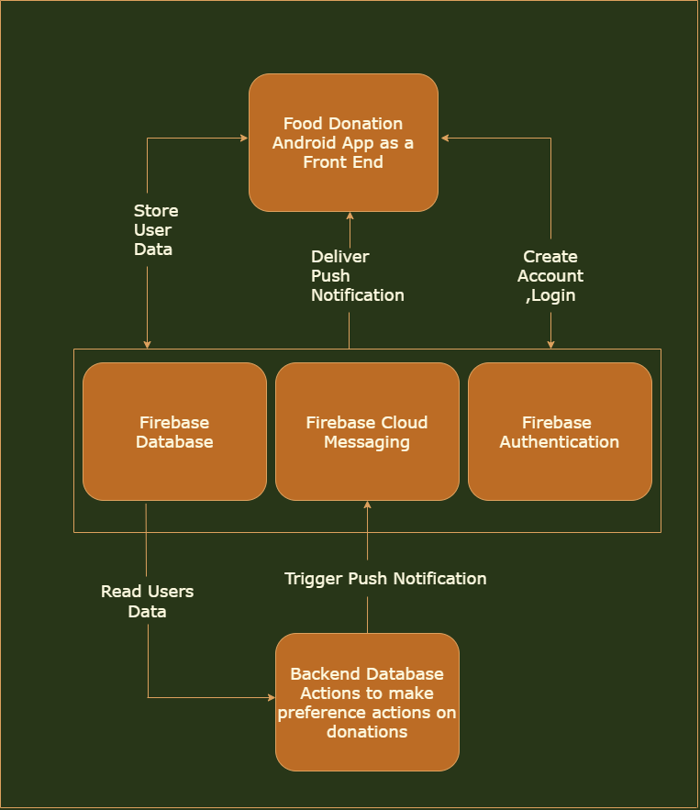
System Architecture

Slide 9
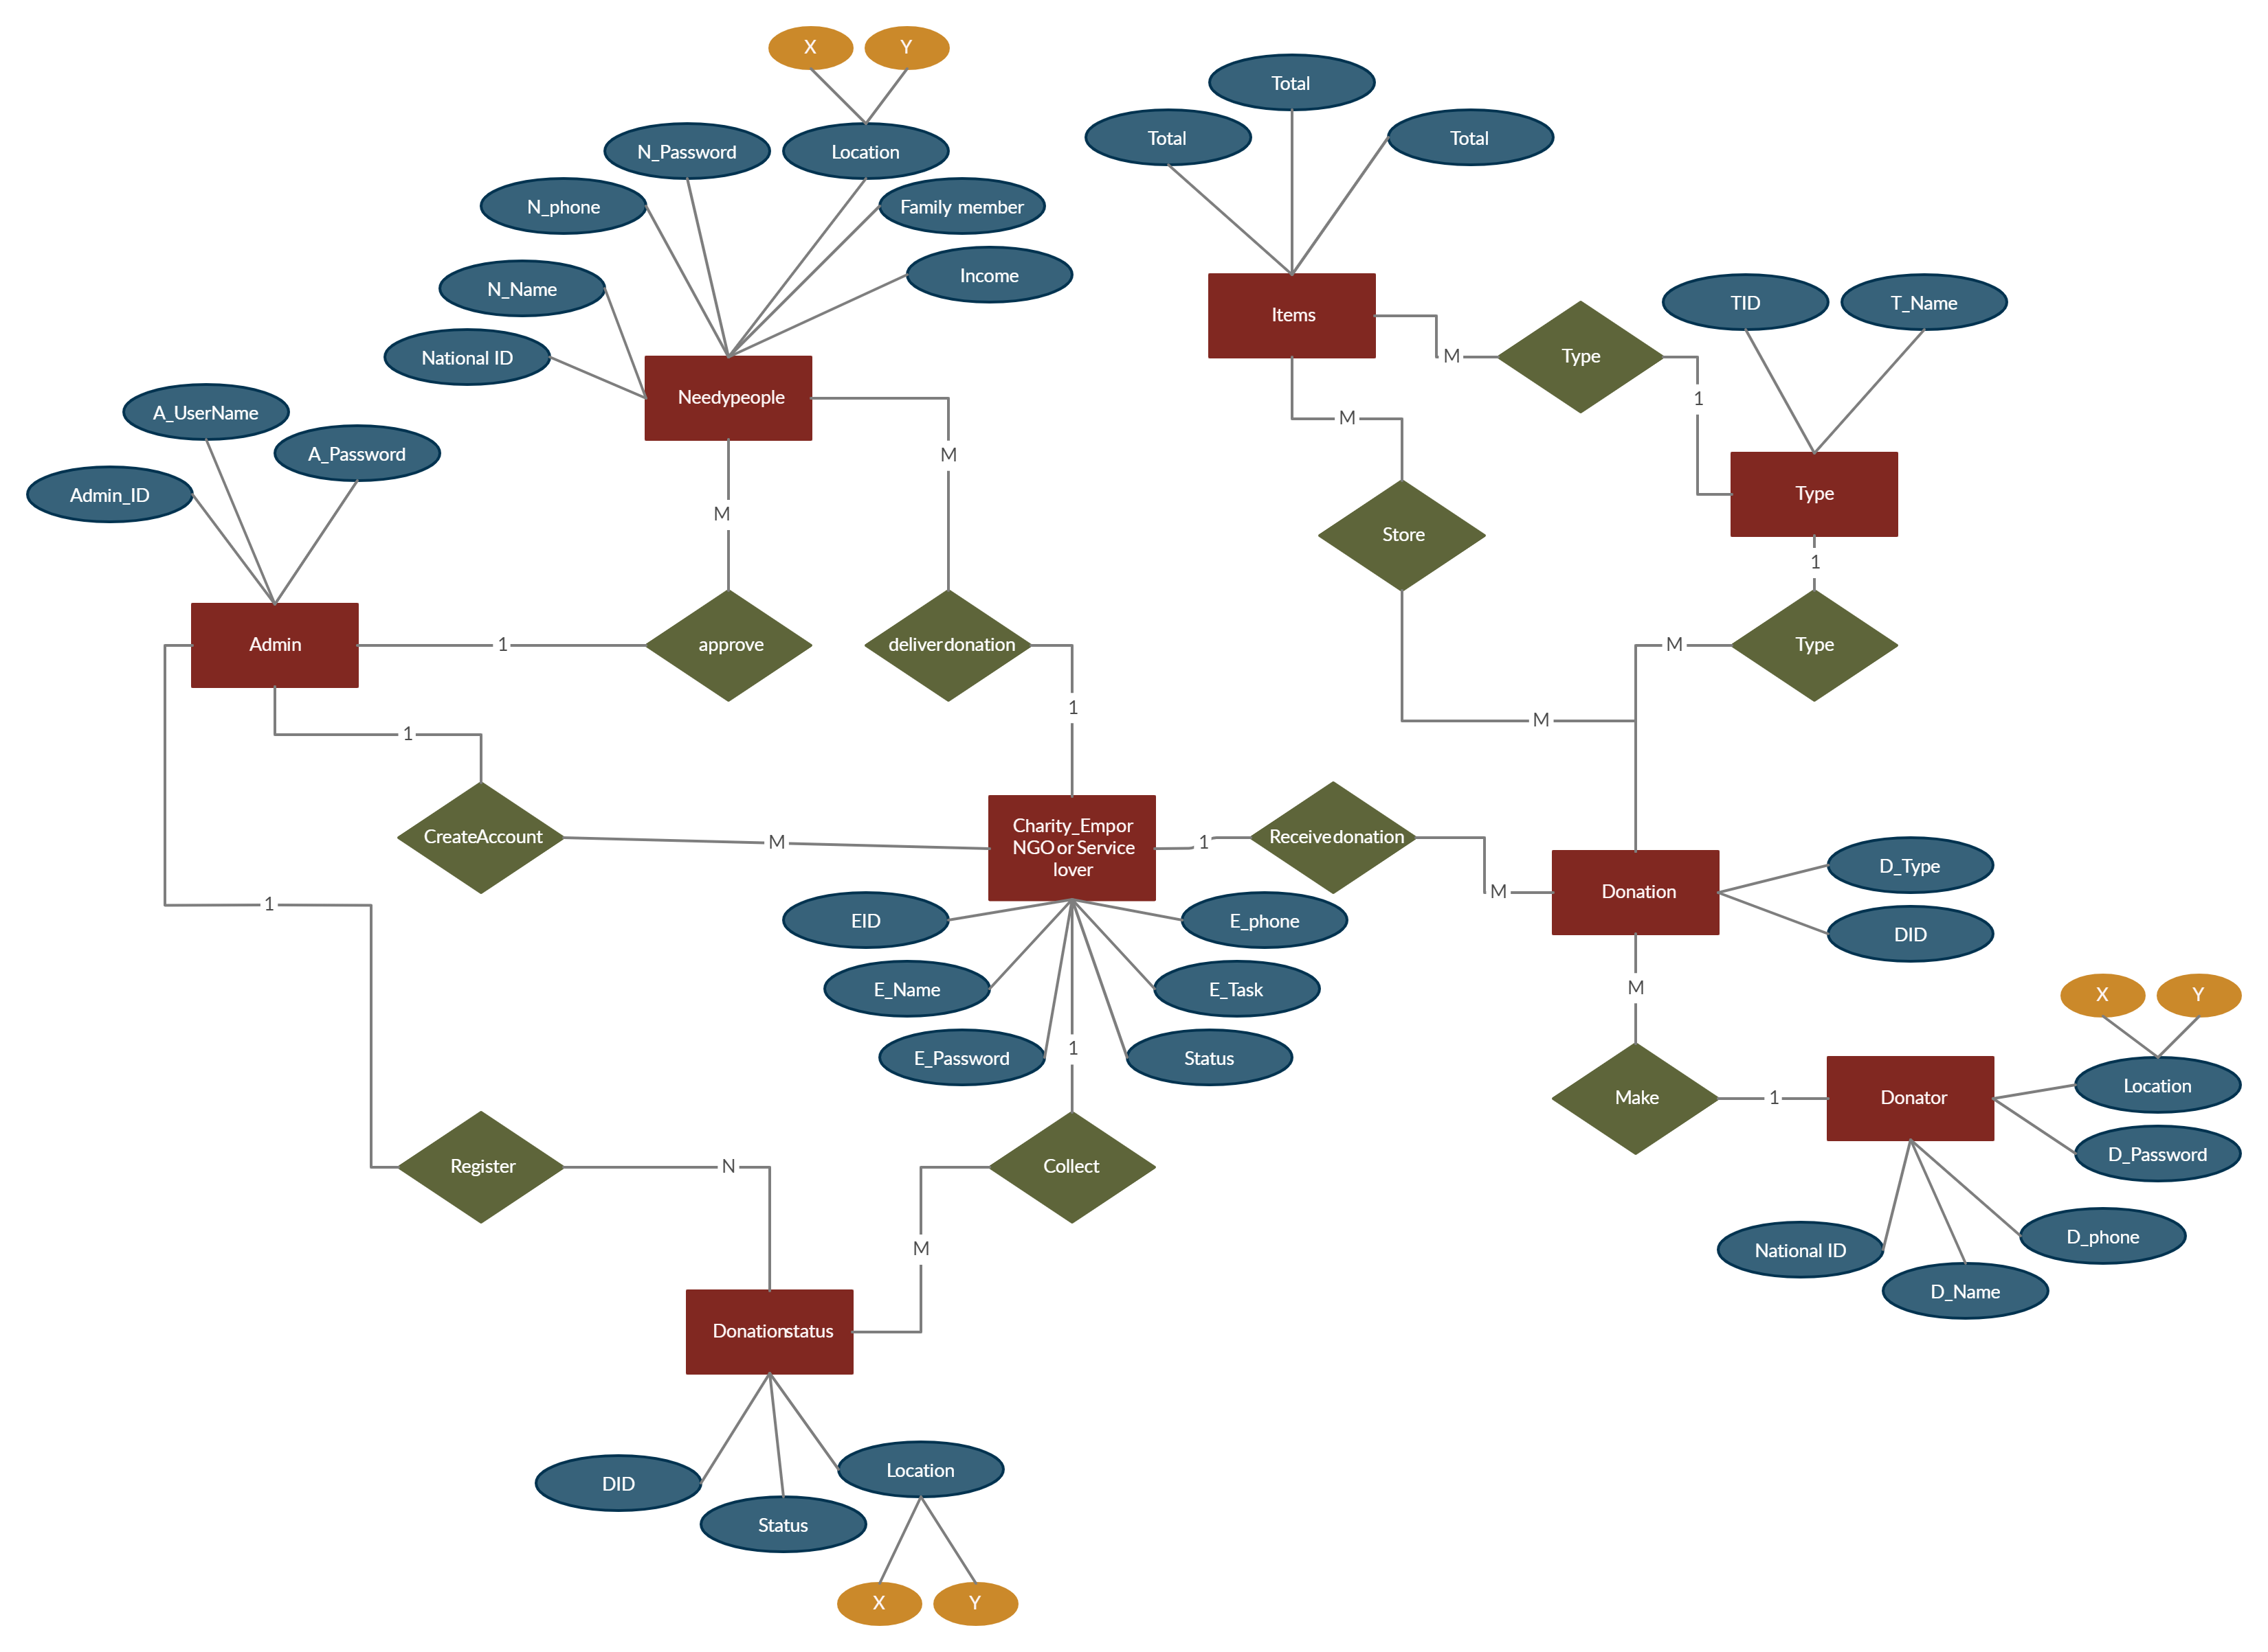
ER Diagram

Slide 10
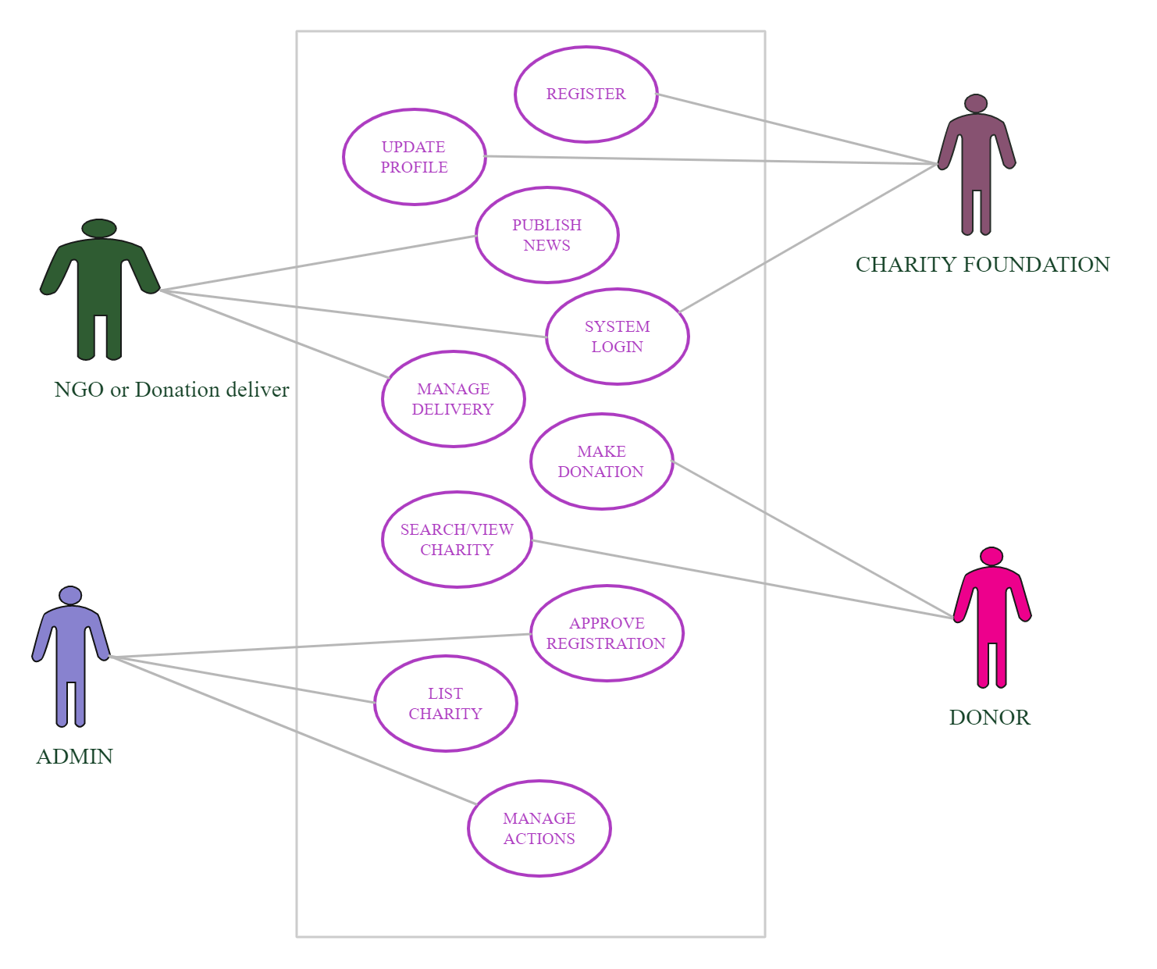
Use Case Diagram

Slide 11
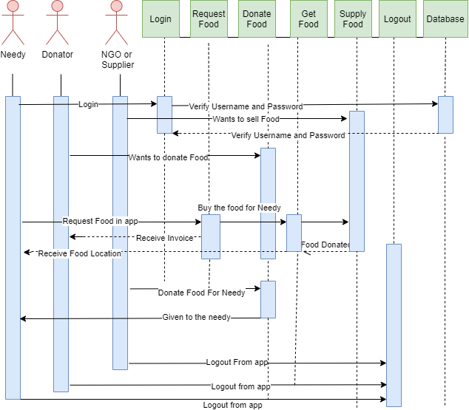
Sequence Diagram

Slide 12
Modules / Functionalities
Login & Registration
This phase involves signing in and registering for both the donor and the
recipient.
The user’s details are maintained confidentially by maintaining a separate
account for each user.
At the same time, the admin can view the details of the registered agent.

Slide 13
Donor Module
In the donor module, the donor gives the leftover food to the orphanage.
The donor gives the request to the admin for the purpose of collecting the
leftover food.
The donor can view the orphanage details.

Slide 14
Receiver Module
In the Receiver module, the Receiver maintains the orphanage details. It can
also view the donor details.
The Receiver gives the request to the admin for collecting the food from the
donor.
After collecting the food, the recipient gives the alert message to the donor.
The Receiver can also track the location of the Donor.

Slide 15
Unit Testing – Login Process
Test Case ID | Test Case / Action To Perform | Expected Result | Actual Result | Pass/ Fail
1. | Enter the correct username and Password | Displays “Username and Password is correct” | Username and Password is Correct | Pass
2. | Click the “Submit” button | Displays “Login is successful” | Login is successful. | Pass

Slide 16
New User Registration
Test Case ID | Test Case / Action To Perform | Expected Result | Actual Result | Pass/ Fail
1. | New user Registration | Displays “Registration Successful” | Registered Successfully | Pass
2. | Login to user Id | Displays “User Login successful” | User Login Correct | Pass

Slide 17
Donation details
Test Case ID | Test Case / Action To Perform | Expected Result | Actual Result | Pass/ Fail
1. | To check the donation details are uploaded well | Donation details are uploaded well. | Valid details | Pass

Slide 18
Receiver Module
Test Case ID | Test Case / Action To Perform | Expected Result | Actual Result | Pass/ Fail
1. | To check the available food items are listed properly. | Available food items are listed well. | Valid list of available food items. | Pass

Slide 19
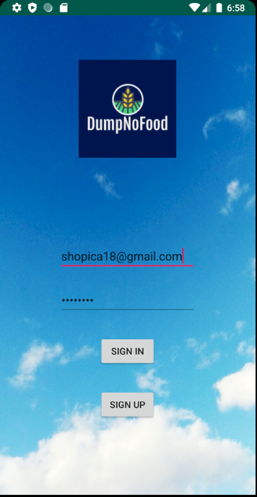
Screenshots Login Page

Slide 20
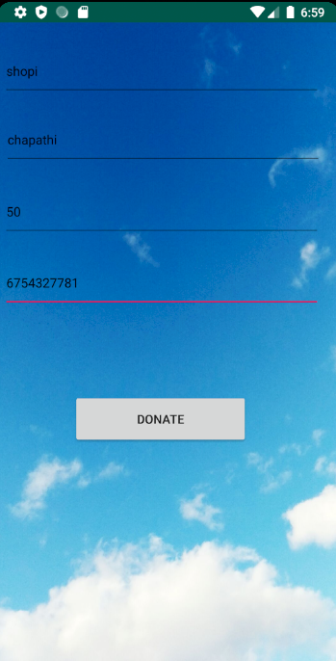
Donor Page

Slide 21
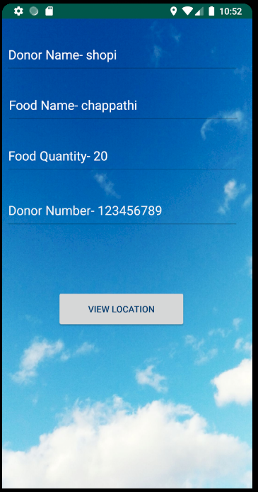
Receiver Page

Slide 22
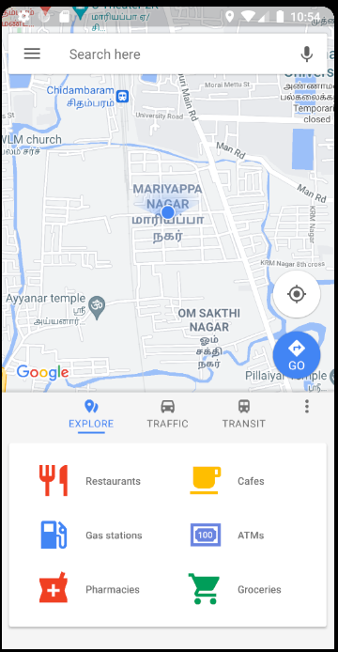
Location Tracking Page

Slide 23
Conclusion
Thus, it's better understood how the proposed system is better than the prevailing system.
The surplus food produced in functions, gatherings are often easily donated to the needy.
This is an attempt focused on feeding the hungry people and minimizing the food wastage problem
at the same time.
Using this application the donor and recipient can communicate with each other directly.
The Donor needs to send a request to the recipient. If they accept, food will be sent to them.
This application is developed to avoid the food scarcity problem.

Slide 24
Publications
Paper Title : Food Wastage Reduction by Donation to Charity Institutions
Published In : International Journal for Research in Applied Science & Engineering
Technology (IJRASET)
ISSN: 2321-9653; IC Value: 45.98; SJ Impact Factor: 7.429
Paper Issue : Volume 9 Issue V May 2021
Available at : https://www.ijraset.com/fileserve.php?FID=34754

Slide 25
References
G. Rovati and L. Pesenti, “Food poverty, Food bank,” Aiutialimentari e inclusionesociale. Vita e Pensiero, Milano, 2015. [Online]. Available: http://www.vitaepensiero.it/scheda-libro/giancarlo-rovati-luca-pesenti/ food-poverty-food-bank-9788834329917-300632.html
M. Schuster and M. Torero, “Reducing food loss and waste,” International Food Policy Research Institute (IFPRI), IFPRI book chapters, 2016. [Online]. Available: http://econpapers.repec.org/bookchap/fprifpric/9780896295827-03.htm
P. Garrone, M. Melacini, and A. Perego, “Opening the black box of food waste reduction,” Food Policy, vol. 46, pp. 129–139, Jun. 2014. [Online]. Available: http://www.sciencedirect.com/science/article/pii/S0306919214000542
J. Gustavsson, C. Cederberg, U. Sonesson, R. Van Otterdijk, and A. Meybeck, “Global food losses and food waste,” Food and Agriculture Organization of the United Nations, Rom, 2011. [Online]. Available: http://www.madr.ro/docs/ind-alimentara/ risipaalimentara/presentation food waste.pdf
A. Halloran, J. Clement, N. Kornum, C. Bucatariu, and J. Magid, “Addressing food waste reduction in Denmark,” Food Policy, vol. 49, Part 1, pp. 294–301, Dec. 2014. [Online]. Available: http://www.sciencedirect.com/science/article/pii/S0306919214001365
E. Ganglbauer, G. Fitzpatrick, O. Subasi, and F. Gueldenpfennig, “Think Globally, Act Locally: A Case Study of a Free Food Sharing Community and Social Networking,” in Proceedings of the 17th ACM Conference on Computer Supported Cooperative Work & Social Computing, ser. CSCW ’14. New York, NY, USA: ACM, 2014, pp. 911–921. [Online]. Available: http://doi.acm.org/10.1145/2531602.2531664
C. Corbo and F. Fraticelli, “The use of web-based technology as an emerging option for food waste reduction,” in Envisioning a future without food waste and food poverty. Wageningen Academic Publishers, Oct. 2015, pp. 133–142. [Online]. Available: http://www.wageningenacademic.com/doi/abs/10.3920/978-90-8686-820-9

Slide 26
THANK YOU

